Slide 1
Dynamic Memory Allocation, Linked List

Slide 2
Dynamic Memory Allocation
Dynamic memory allocation allows a program to obtain more memory space, while running or to release space when no space is required.

Slide 3
Stack and Heap
Using a combination of RAM and virtual memory, all software programs use their own area of memory called the stack. Every time a function is called in a program, the function’s variables and parameters are pushed onto the program’s memory stack and then pushed off or “popped” when the function has completed or returned.
After software programs have terminated, memory is returned for reuse for other software and system programs. Moreover, the operating system is responsible for managing this realm of unallocated memory, known as the heap.
Once a program frees memory, it is returned back to the heap for further use by the same program or other programs.
In a nutshell, memory allocating functions and the heap are extremely important to C programmers because they allow you to control a program’s memory consumption and allocation. The remainder of this chapter will show you how to retrieve and return memory to and from the heap.

Slide 4
Memory Allocation
Stack memory allocation
Non-static local variable is an example of stack memory allocation.
Such memory allocations are placed in a system memory area called the stack.
Static memory allocation
Static local variable and global variable require static memory allocation. Static memory allocation happens before the program starts, and persists through the entire life time of the program.

Slide 5
Dynamic memory allocation
It allows the program determine how much memory it needs at run time, and allocate exactly the right amount of storage.
The region of memory where dynamic allocation and deallocation of memory can take place is called the heap.
Note: the program has the responsibility to free the dynamic memory it allocated.

Slide 6
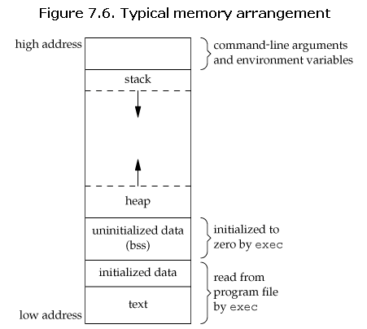
Memory arrangement

Slide 7
sizeof()
The sizeof operator takes a variable name or data type as an argument and returns the number of bytes required to store the data in memory.

Slide 8
malloc()
Sometimes it is impossible to know exactly how much memory your program will need for a given function. Fixed-sized arrays may not be large enough to hold the amount of data you are requesting to store.
C provides a few functions for creating dynamic memory, one of which is the malloc() function. The malloc() function is part of the standard library <stdlib.h> and takes a number as an argument. When executed, malloc() attempts to retrieve designated memory segments from the heap and returns a pointer that is the starting point for the memory reserved. The function malloc() reserves a block of memory of specified size and return a pointer of type void which can be casted into pointer of any form.
Syntax of malloc:
ptr=(cast-type*)malloc(byte-size)

Slide 9
#include <stdio.h>
#include <stdlib.h>
void main()
{
char *name;
name = (char *) malloc(80 * sizeof(char));
if ( name == NULL )
printf("\nOut of memory!\n");
else
printf("\nMemory allocated.\n");
} //end main

Slide 10
#include <stdio.h>
#include <stdlib.h>
int main(){
int n,i,*ptr,sum=0;
printf("Enter number of elements: ");
scanf("%d",&n);
ptr=(int*)malloc(n*sizeof(int)); //memory allocated using malloc
if(ptr==NULL)
{
printf("Error! memory not allocated.");
exit(0);
}
printf("Enter elements of array: ");
for(i=0;i<n;++i)
{
scanf("%d",ptr+i);
sum+=*(ptr+i);
}
printf("Sum=%d",sum);
free(ptr);
return 0;
}

Slide 11
Freeing Memory
Good programming practice dictates that you free memory after using it. For this reason, the C standard library offers the free() function, which takes a pointer as an argument and frees the memory the pointer refers to. This allows your system to reuse the memory for other software applications or other malloc() function calls,
Syntax:
free(ptr);

Slide 12
#include<stdio.h>
#include<stdlib.h>
int main()
{
int *ptr_one;
ptr_one = (int *)malloc(sizeof(int));
if (ptr_one == 0)
{
printf("ERROR: Out of memory\n");
return 1;
}
*ptr_one = 0;
printf("%d\n", *ptr_one);
free(ptr_one);
return 0;
}

Slide 13
calloc( )
Another memory allocating tool is the C standard library <stdlib.h> function calloc(). Likethe malloc() function, the calloc() function attempts to grab contiguous segments of memory from the heap.
The calloc() function takes two arguments: the first determines the number of memory segments needed and the second is the size of the data type.
Syntax of calloc()
ptr=(cast-type*)calloc(n,element-size);

Slide 14
#include <stdio.h>
#include <stdlib.h>
int main(){
int n,i,*ptr,sum=0;
printf("Enter number of elements: ");
scanf("%d",&n);
ptr=(int*)calloc(n,sizeof(int));
if(ptr==NULL)
{
printf("Error! memory not allocated.");
exit(0);
}
printf("Enter elements of array: ");
for(i=0;i<n;++i)
{
scanf("%d",ptr+i);
sum+=*(ptr+i);
}
printf("Sum=%d",sum);
free(ptr);
return 0;
}

Slide 15
realloc( )
the realloc() function provides a way to expand contiguous blocks of memory while preserving the original contents.
Syntax:
ptr=realloc(ptr,newsize);

Slide 16
Linked Design
It the type of ADT Design that is used when we need to manipulate dynamic structures which change in size and shape at run time.

Slide 17
Linked List
It is a type of data structure consisting of group of nodes which together represent a sequence. It consists of a series of structures, which are not necessarily adjacent in memory. Central to this representation is the concept of a node, a field and a pointer.
The implementing construct for the linked list is the node.

Slide 18
Linked List
Node – it is an addressable unit of memory which consists of named segments called fields.
fn1
fn2
fn3
. . .
fn_
val 1 | val 2 | val 3 | . . . | val _
addr
Where:
addr – is the address of the node
fn1, fn2, … - are the names of the fields comprising the node.
val1, val2, …. – are the values in the fields of the node

Slide 19
More on Linked List
A node has no name, so we refer it through its address. As an example consider the following node:
INFO
LINK
Jesus | 1000
α

Slide 20

More on Linked List
Now consider the following node
3000
Jesus | 1000
1000
Mary | 4000
4000
Joseph | ^
When a field in this instance the LINK field, of a node contains the address of another node, we say that the LINK field of the former contains a pointer to the latter. Hence we can illustrate this by the illustration below:
Jesus
Mary
Joseph | ^

Slide 21
Linked list example
/* LLIST.C Program to illustrate linked lists */
#include <stdio.h>
struct list {
int value;
struct list *next;
};
main()
{
struct list jesus, mary, joseph;
int i;
jesus.value = 1000;
mary.value = 4000;
Joseph.value = 0;
jesus.next = &mary;
mary.next = &joseph;
joseph.next = 0;
i = n1.next->value;
printf("%d\n", i);
printf("%d\n", n2.next->value);
}

Slide 22
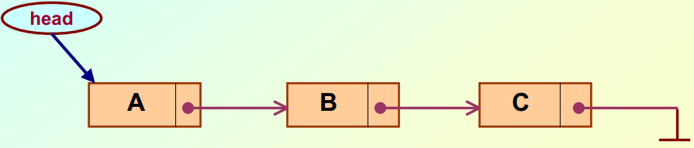
Types of Linked List
Linear singly-linked list (or simply linear list)
One we have discussed so far.

Slide 23
Singly – linked list
#include <stdlib.h>
#include <stdio.h>
struct node {
int x;
struct node *next;
};
void main()
{
/* This will be the unchanging first node */
struct node *head;
/* Now root points to a node struct */
head = malloc( sizeof(struct node) );
/* The node root points to has its next pointer equal to a null pointer
set */
head->next = 0;
/* By using the -> operator, you can modify what the node,
a pointer, (root in this case) points to. */
head->x = 5;
printf("%d",head->x);
}

Slide 24
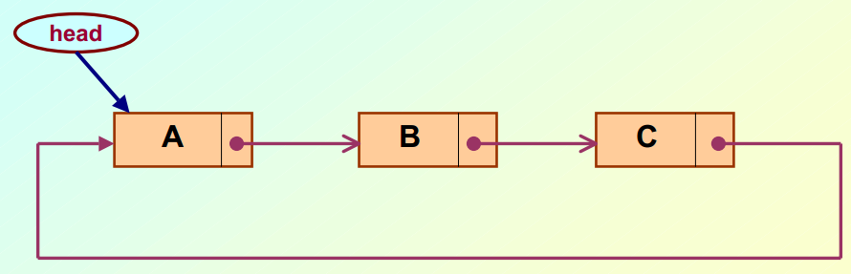
Types of Linked List
Circular linked list
The pointer from the last element in the list points back to the first element.

Slide 25
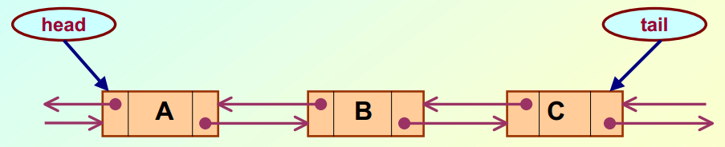
Types of Linked List
Doubly linked list
Pointers exist between adjacent nodes in both directions.
The list can be traversed either forward or backward.
Usually two pointers are maintained to keep track of the list, head and tail.

Slide 26
Basic Operations on a Linked List
Creating a list
Traversing the list
Inserting an item in the list
Deleting an item from the list

Slide 27
Linked list basic operation example
//Basic Linked list operation
#include <stdio.h>
#include <conio.h>
#include <stdlib.h>
#include <string.h>
/* Program for single linked list which inserts / deletes data into linked list. */
// Structure templates
struct list
{
int no;
struct list *shortlink;
};
typedef struct list node;
node *head = NULL;
void init(node*);
void InsertNode();
void DeleteNode();
void DisplayList();
void main()
{
char ch = 'n';
int opt;
do
{
printf("\nEnter your option\n");
printf("\n1. Insert a node\n");
printf("\n2. Delete a particular node\n");
printf("\n3. Display all the nodes\n");
printf("\n4. Exit the application\n");
scanf("%d",&opt);
switch(opt)
{
case 1:
InsertNode();
DisplayList();
break;
case 2:
DeleteNode();
DisplayList();
break;
case 3:
DisplayList();
break;
case 4:
ch = 'y';
break;
}
}while(ch != 'y');
printf("\nDone by \"SHABBIR\"\n");
getch();
}
void init(node *current)
{
printf("\nEnter number\n");
scanf("%d",&current->no);
current->shortlink = NULL;
}
void InsertNode()
{
node *newnode;
newnode=(node*)malloc(sizeof(node));
init(newnode);
if(head == NULL)
{
head = newnode;
}
else
{
node *current = head;
// Move to the end of the linked list
while(current->shortlink!=NULL)
{
current=current->shortlink;
}
if(current->shortlink==NULL)
{
newnode->shortlink = current->shortlink;
current->shortlink = newnode;
}
}
}
void DeleteNode()
{
node* current = head;
int rno;
node *newnode,*temp;
printf("\nEnter the number whose node you want to delete\n");
scanf("%d",&rno);
newnode=current;
if(current->no==rno)
{
// Deleting the first node
newnode=current;
current=current->shortlink;
free(newnode);
head = current;
return;
}
else
{
while(newnode->shortlink->shortlink!=NULL)
{
// Checking condition for deletion of
// all nodes except first and last node
if(newnode->shortlink->no==rno)
{
temp=newnode->shortlink;
newnode->shortlink=newnode->shortlink->shortlink;
free(temp);
head = current;
return;
}
newnode=newnode->shortlink;
}
if(newnode->shortlink->shortlink==NULL && newnode->shortlink->no==rno)
{
// Checking condition for deletion of last node
free(newnode->shortlink);
newnode->shortlink=NULL;
head = current;
return;
}
}
}
void DisplayList()
{
node* current = head;
while(current!=NULL)
{
printf("\n %d ",current->no);
current=current->shortlink;
}
}

Slide 28
Using Typedef With Structures
It allows us to introduce synonyms for data types which could have been declared some other way.
It is used to give New name to the Structure.
New name is used for Creating instances, Passing values to function,declaration etc…

Slide 29
Typedef example
#include<stdio.h>
int main()
{
typedef int Number;
Number num1 = 40,num2 = 20;
Number answer;
answer = num1 + num2;
printf("Answer : %d",answer);
return(0);
}

Slide 30
Typedef with structure example
#include<stdio.h>
typedef struct b1 {
char bname[30];
int ssn;
int pages;
}book;
book b1 = {"Let Us C",1000,90};
int main()
{
printf("\nName of Book : %s",b1.bname);
printf("\nSSN of Book : %d",b1.ssn);
printf("\nPages in Book : %d",b1.pages);
return(0);
}

Slide 31
Assignment
Put your name and yr. & section as comment in every code . Email your assignment at jethrogamad@gmail.com
Create a program that uses malloc() to allocate a chunk of memory to hold a string no larger than 80 characters. Prompt the user to enter his favorite movie. Read his response with scanf() and assign the data to your newly allocated memory. Display the user’s favorite movie back to standard output. Save as dma.c
Create a singly linked list that will display 4 names: Anna, John, Jim, Silver. Implement the linked lists basic operations. Save as linkedlist.c

